Slide 1
IOT_PHASE_2
AIR QUALITY MONITORING

Slide 2

OVER VIEW:
An IoT-based air and sound pollution monitoring system is implemented using a network of sensors, connectivity technologies, and data analytics platforms.
Air quality sensors are deployed in strategic locations to measure pollutant levels such as particulate matter, gases, and volatile organic compounds (VOCs).

Slide 3

NEED OF PROJECT:
IMPROVE AIR QUALITY – MONITORING HELPS TO IDENTIFY AREAS
01
TO MAINTAIN ITS MONITORING IS ESSENTIAL
02
These measures reduce local air pollution and often noise, and they improve residents' quality of life.
03

Slide 4

problems statement
Air Pollution: A Growing Concern
Air pollution is a major problem that affects people all around the world. It can cause a range of health problems, from respiratory issues to heart disease. With the increasing population and industrialization, the problem is only getting worse. This makes it essential to monitor air quality effectively and efficiently.

Slide 5

COMPANENTS:
REQUIRED COMPONENTS:
1.ARDUINO UNO
2.16X2 LCD SCREEN
3.MQ135 SENSOR
4.ESP8266 MODULE
5.WIFI
6.CONNECTING WIRES

Slide 6
Block Diagram of Arduino based IOT device for Real Time Air Pollution Monitoring

Slide 7
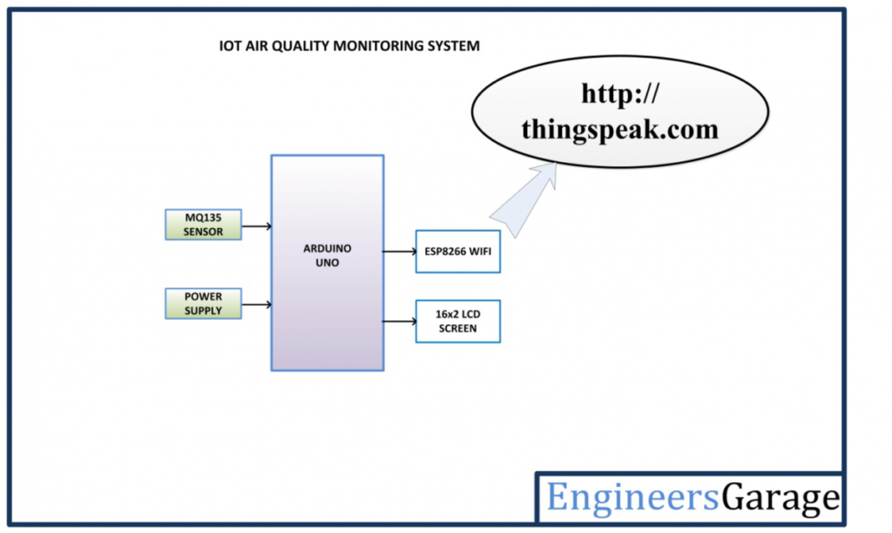




Black diagram

Slide 8
Circuit Connections –

Slide 9
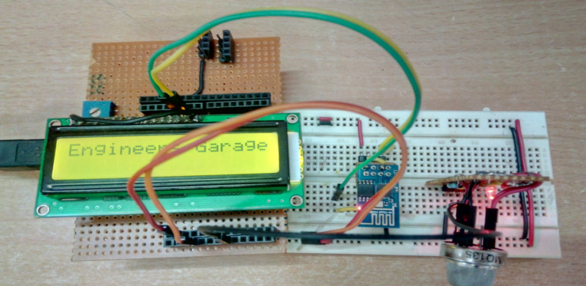

Slide 10
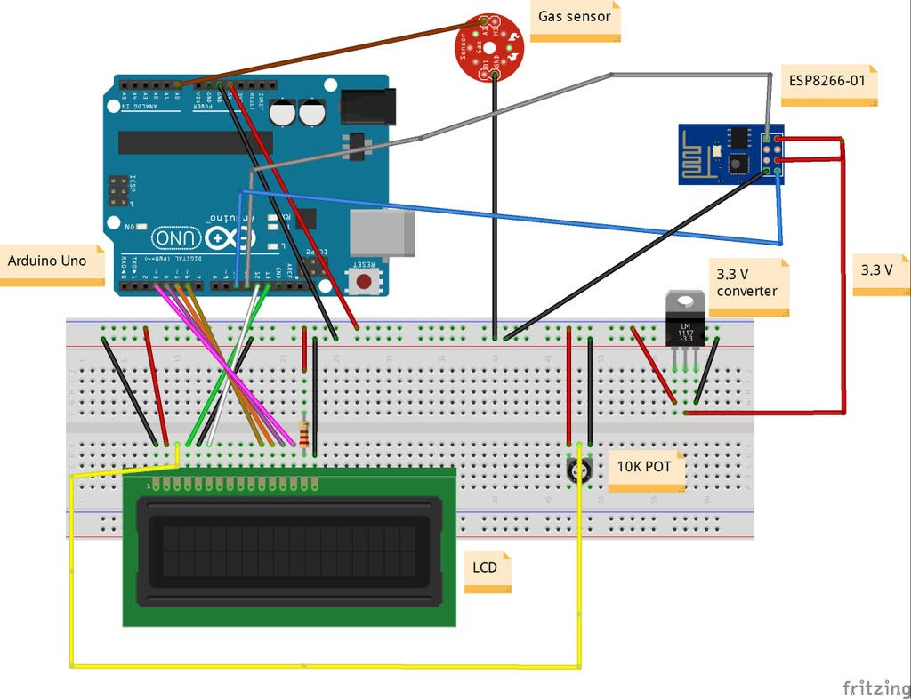
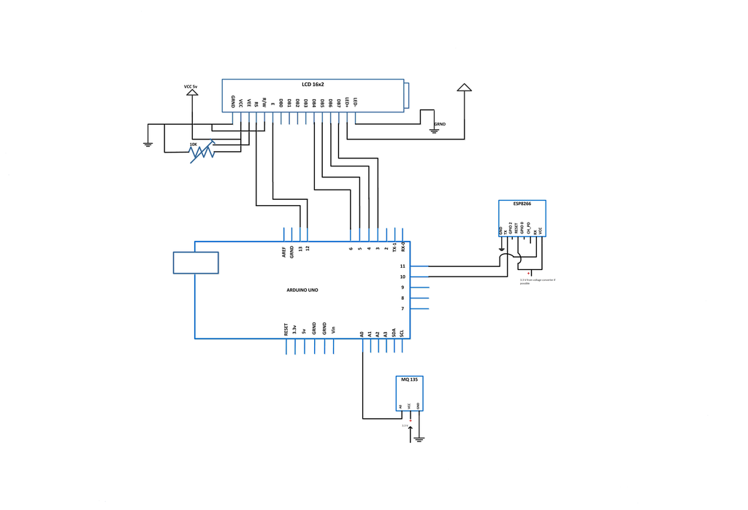

Slide 11
How the circuit works –
The device developed in this project can be installed near any Wi-Fi hotspot in a populated urban area. As the device is powered, the Arduino board loads the required libraries, flashes some initial messages on the LCD screen and start sensing data from the MQ-135 sensor. The sensitivity curve of the sensor for different combustible gases is already mentioned above. The sensor can be calibrated so that its analog output voltage is proportional to the concentration of polluting gases in PPM. The analog voltage sensed at the pin A0 of the Arduino is converted to a digital value by using the in-built ADC channel of the Arduino. The Arduino board has 10-bit ADC channels, so the digitized value ranges from 0 to 1023. The digitized value can be assumed proportional to the concentration of gases in PPM. The read value is first displayed on LCD screen and passed to the ESP8266 module wrapped in proper string through virtual serial function.

Slide 12
Out
Put

Slide 13
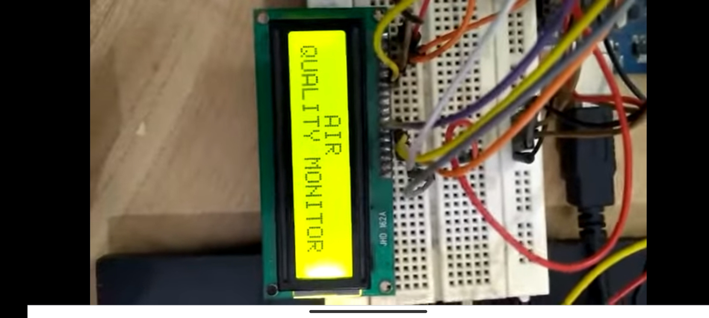
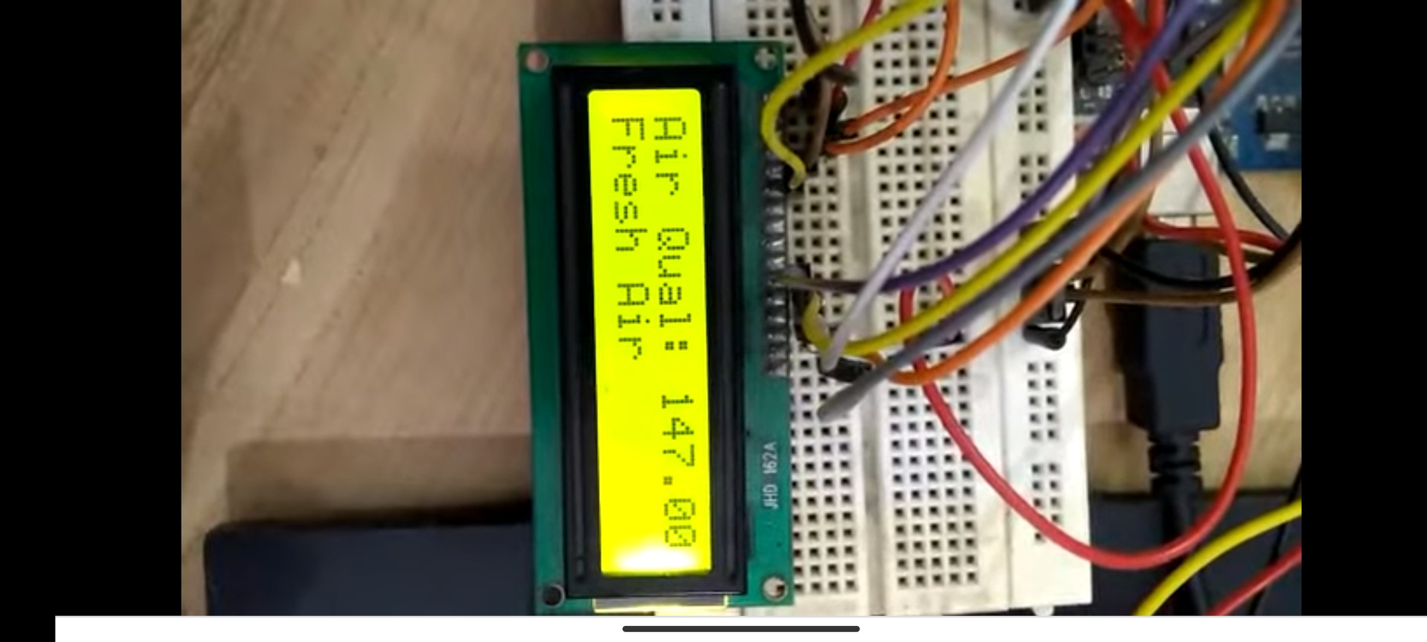

Slide 14
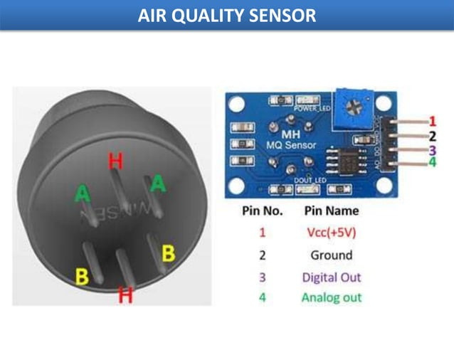


Air quality sensor
• Gas Sensor(MQ2) module is useful for gas leakage detection. (home and industry)
• It is suitable for detecting H2, LPG, CH4, CO, Alcohol, Smoke or Propane.
Due to its high sensitivity and fast response time, measurement can be taken as soon as possible.
• The sensitivity of the sensor can be adjusted by potentiometer.

Slide 15

Feature
Wide detecting scope.
Stable and long life time.
• Fast response.
25
20
15
10
5
0
Element 1
Element 2
Element 3
Element 4
Element 5

Slide 16
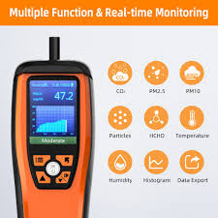



Air quality monitoring tester

Slide 17
Future scope
25
*This IOT based air and sound pollution monitoring device is a great step towards a healthy livelihood.
*With the help of this device not only the municipal authorities but even the common people can participate in the process of controlling pollution and
ensure safe environment We will work on displaying the amount of poisonous gases detected by sensor
Since with time the upgrade in sensor will take place such as range of detection.
20
15
5
0
Element 1
Element 2
Element 3
Element 4
Element 5

